Slide 1
Module 5 – Variable Types and Basic Python Execution Control Constructs
Sharon ONeal
sharononeal@email.arizona.edu
520-822-4040

Slide 2
Unit 1 – Module 5 Overview

Slide 3
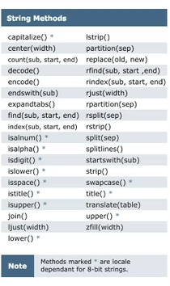
Python Strings
What is a ‘String’?
Strings are a type of data variable
Strings are a sequence of alphanumeric characters
An ‘index” is used to indicate a specific position within a string
Strings typically have a pre-determined length, i.e:
US phone numbers have 10 numeric characters
There are numerous typical string ‘methods’ that can be used/reused to manipulate and control string variables

Slide 4
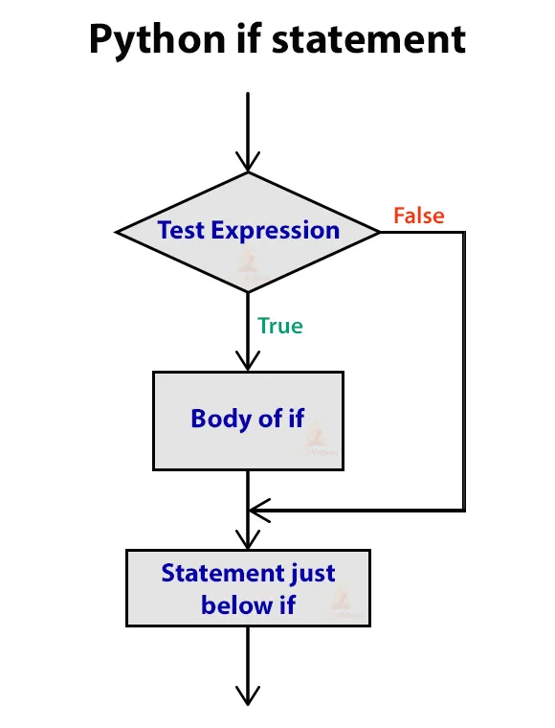
Python Branching
Summary of Python branching Constructs (or conditional expressions)
Python branch statements are a way to control what portions of the code will get executed depending on a given set of conditions
Popular branching constructs include:
“if” statements
“if-else” statements
“if-elif-else” blocks

Slide 5
Python Loops
Summary of Python Loops
‘while’ loops
‘for’ loops
Nested loops
Loop control
A loop is a program construct that repeatedly executes the loop’s statements (loop body) while the loop expression is true
When the loop expression is false, execution continues to the statements past the loop body
Each time through a loop is called an ‘iteration’
Two primary types of loops:
‘while’ loops
‘for’ loops
Loops can be nested within other loops
Execution within a loop can also be terminated by the code invoking a ‘break’ statement

Slide 6
Unit 2 – Module 5 “To Do List”: Complete the Following in the zyLabs Interactive Textbook

Slide 7

Read and Complete the Interactive Portions Shown to the Right
Read / Learn / practice:
Chapter 4 –Python Strings
4.1 String slicing
4.2 Advanced string formatting
4.3 String methods
4.4 Splitting and joining strings

Slide 8
Read and Complete the Interactive Portions Shown to the Right
Read / Learn / practice:
Chapter 5 – Python Branching
5.1 If-else branches (general)
5.2 Detecting equal values with branches
5.3 Detecting ranges with branches (general)
5.4 Detecting ranges with branches
5.5 Detecting ranges with Logical Operators
5.6 Detecting ranges with gaps
5.7 Detecting multiple features with branches
5.8 Comparing data types and common errors
5.9 Membership identity operators
5.10 Order of evaluation
5.11 Code blocks and indentation
5.12 Conditional expressions

Slide 9
Read and Complete the Interactive Portions Shown to the Right
Read / Learn / practice:
Chapter 6 – Python Loops
6.1 Loops (general)
6.2 While loops
6.3 More while examples
6.4 Counting
6.5 For loops
6.6 Counting using the range() function
6.7 While vs for loops
6.8 Nested loops
6.9 Developing programs incrementally
6.10 Break and continue
6.11 Loop else

Slide 10

Complete the Following Labs in Chapters 4 - 6
4.5 LAB: Checker for integer string
4.6 LAB: Longest String
5.14 LAB: Smallest number
5.15 LAB: Seasons
6.12 LAB: Print string in reverse
6.13 LAB: Password modifier

Slide 11
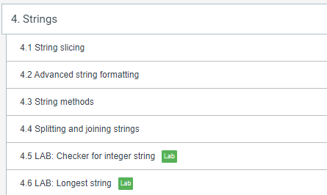
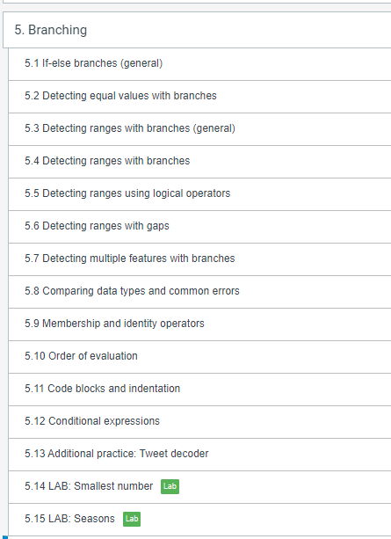
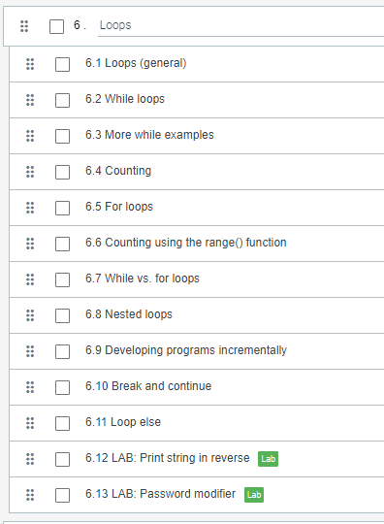
In Summary: Your zyBooks Assignment for Module 5

Slide 12
Chapter 5 – Branching
5.1 If-else branches
Zybooks in class activities
Walk thru Chapter 5.1 (in presentation mode)
In table groups, complete 5.16 LAB Golf Scores

Slide 13

Time to Get Back Into the Groove
Look ahead over the next 2 weeks:
3/14: Finish Chapter 5
3/16 – 3/18: Finish Chapter 6
3/18: zyLabs 5.14 and 5.15 due
3/21: zyLabs 6.12 and 6.13 due
3/21: Midterm #2 Review (In-class)
3/23: Midterm #2
Open Book / Open notes
Chapters 1-6
Mostly coding related
Must be present in class to take exam if you are an on-campus student
Must take exam during normal class time

Slide 14
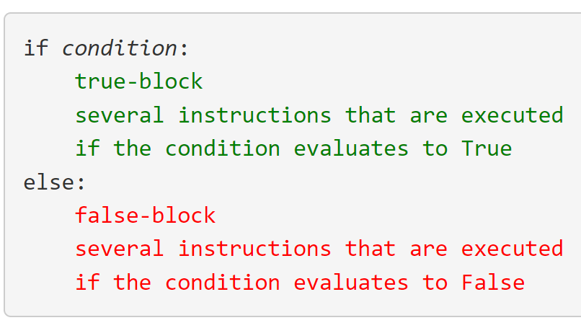
Chapter 5 – Python Branching
5.2 Detecting equal values with branching
What do the following comparison operators check for :
==
<
>
<=
>=
!=
= (how is this different?)
What is the format of a basic if – then-else statement?
Zybooks in class activities

Slide 15
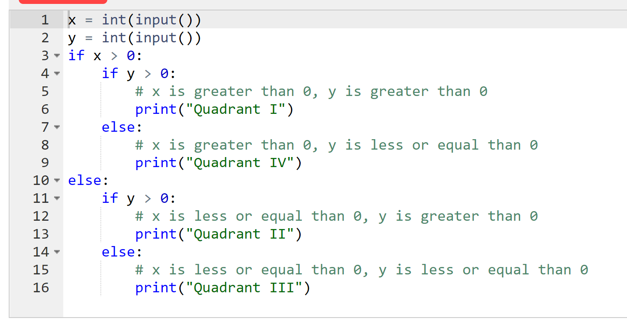
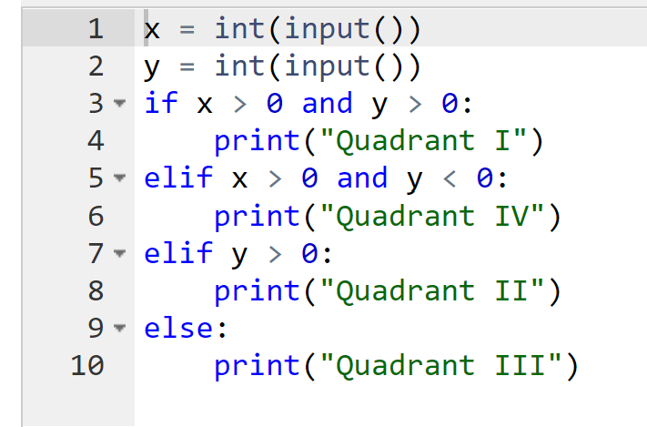
Chapter 5 – Python Branching
5.2 Detecting equal values with branching
What is the format of a nested if-then- else statement?
What is the format of a if-then- else if statement?
Zybooks in class activities

Slide 16
Chapter 5 – Python Branching
5. 4 Detecting ranges with branches
Participation Activity 5.4.4
Participation Activity 5.4.5
What is operator chaining?
What do these expressions equate to (left to right):
x * x < 1000
a == b == c
x <=y >= 10
Participation activity 5.4.6
Zybooks in class activities

Slide 17
Chapter 5 – Python Branching
5. 4 – 5.7 Detecting ranges using logical operators
AND evaluates to True only if BOTH operands are True.
OR evaluates to True if ANY operand is True (one, the other, or both).
NOT evaluates to the opposite of the operand.
Each operand is commonly an expression itself, i.e.:
If x = 7, y = 9, then (x > 0) AND (y < 10) is True
Participation Activity 5.5.2
Participation Activity 5.5.4
Participation Activity 5.5.7
Participation Activity 5.6.4
Zybooks in class activities

Slide 18
Chapter 5 – Python Branching
5.8 Comparing Data Types and common errors
The relational and equality operators work for integers, characters, and floating-point numbers.
Floating-point types should not be compared using the equality operators, due to the imprecise representation of floating-point numbers. (0.3 * 3) + 0.1 == 1
The operators can also be used for the string type. Strings are equal if they have the same number of characters and corresponding characters are identical.
If string my_str = 'Tuesday', then (my_str == 'Tuesday') is True,
(my_str == 'tuesday') is False because T differs from t.
Zybooks in class activities

Slide 19
Chapter 5 – Python Branching
5.8 Comparing Data Types and common errors
Numbers are arithmetically compared.
Strings are compared by converting each character to a number value (ASCII or Unicode), and then comparing each character in order. Most string comparisons use equality operators "==" or "!=", as in today == 'Friday'.
Lists and tuples are compared via an ordered comparison of every element in the sequence.
Every element between the sequences must compare as equal for an equality operator to evaluate to True. Relational operators like < or > can also be used:
The result is determined by the first mismatching elements in the sequences. For example, if x = [1, 5, 2] and y = [1, 4, 3], then evaluating x < y first evaluates that 1 and 1 match.
The next elements do not match, so 5 < 4 is evaluated, which produces a value of False.
Dictionaries are compared only with == and !=. To be equal, two dictionaries must have the same set of keys and the same corresponding value for each key.
Zybooks in class activities

Slide 20
Chapter 5 – Python Branching
5.8 Comparing Data Types and common errors
Common branching errors:
A common error is to use = rather than == in an if-else expression, as in:
if numDogs = 9:
In such cases, the interpreter should generate a syntax error.
Another common error is to use invalid character sequences like
=>, !<, or <>, which are not valid operators.
Participation Activity 5.8.3
What are membership operators?
One common programming task involves determining whether a specific value can be found within a container, such as a list or dictionary.
The in and not in operators, known as membership operators,
Yield True or False if the left operand matches the value of some element in the right operand, which is always a container.
Zybooks in class activities

Slide 21
Chapter 5 – Python Branching
5.9 Comparing Data Types and common errors
What does the identity operator do?
How it is expressed in Python?
is or is not
Check whether two operands are bound to a single object
They do not compare values, they compare identifiers
i.e. Memory address
Common error is to confuse “==“ with the identity operand “is”
Zybooks in class activities

Slide 22
Chapter 5 – Python Branching
5.10 Order of evaluation and 5.11 Code Blocks
Order of evaluation
See table 5.10.1
Participation Activity 5.10.2
Common errors occur when missing parenthesis
Always good practice to use parenthesis for clarity
Participation activity 5.10.3
Go over code block and indentation rules
Figure 5.11.1
Zybooks in class activities

Slide 23
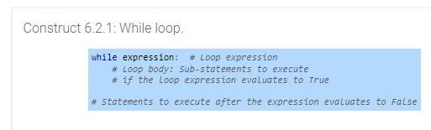
Chapter 6 – Loops
Loop Basics
Go over Loop Basics
Participation Activity 6.1.3
Participation Activity 6.1.4
Participation Activity 6.1.5
Participation Activity 6.1.7
Participation Activity 6.1.9
Format of a while loop in Python (see figure to the right)
Zybooks in class activities
Each time thru the while loop is called an iteration
Loop body
Is this statement part of the while loop?

Slide 24
Chapter 6 – Loops
Basic while loops
Participation Activity 6.2.2
What is an infinite loop in Python?
How do you prevent an infinite loop from happening in Python? (best practice with coding)
Participation activity 6.2.5
Challenge activity 6.2.2 (need volunteer)
Challenge activity 6.2.3 (need volunteer)
zyDE 6.3.1 While loop example: GCD program
Participation Activity 6.3.1
Zybooks in class activities

Slide 25
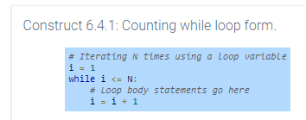
Chapter 6 – Loops
Basic while loops
zyDE 6.3.3 Computing average of a list with a sentinel
Participation 6.3.3
Counting with while loops
Participation Activity 6.4.2
Zybooks in class activities

Slide 26
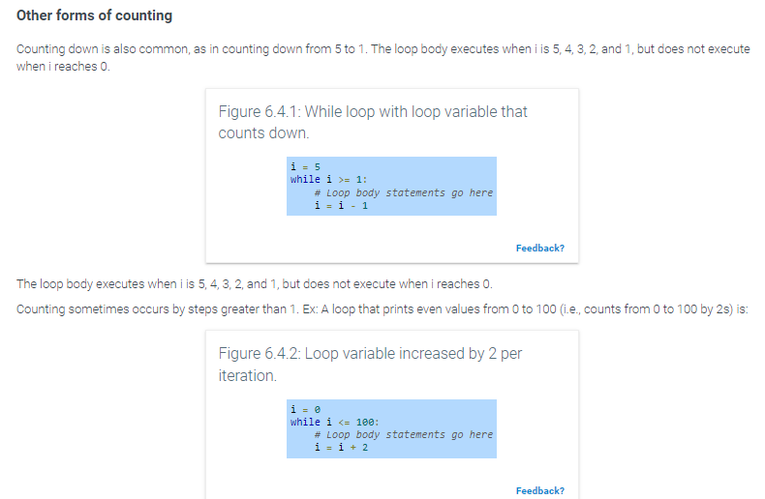
Chapter 6 – Loops
counting while loops
Other forms of counting with while loops
Participation 6.4.3
Challenge Activity 6.4.2 (need volunteer)
Zybooks in class activities

Slide 27
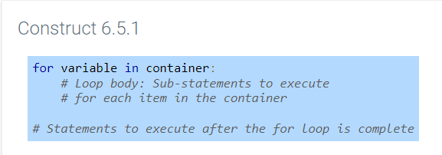
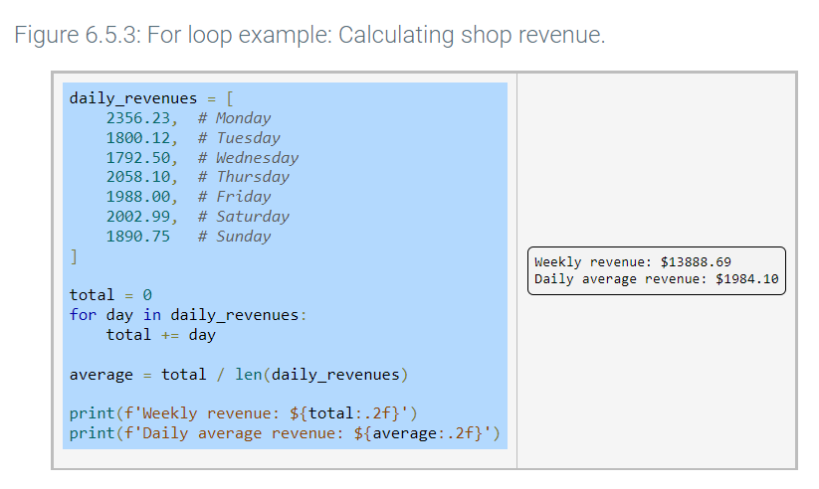
Chapter 6 – Loops
For Loops
for loop syntax:
for loop example:
Zybooks in class activities

Slide 28
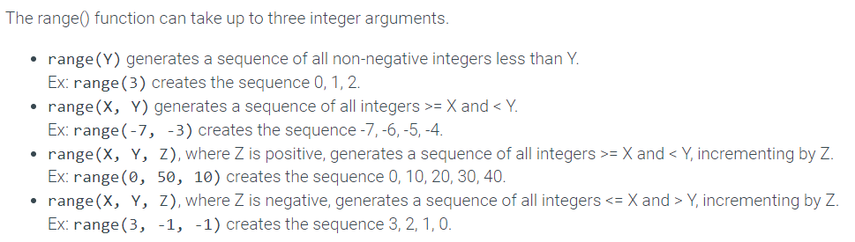
Chapter 6 – Loops
Counting using the Range Function
The range() function allows counting in for loops
Zybooks in class activities

Slide 29
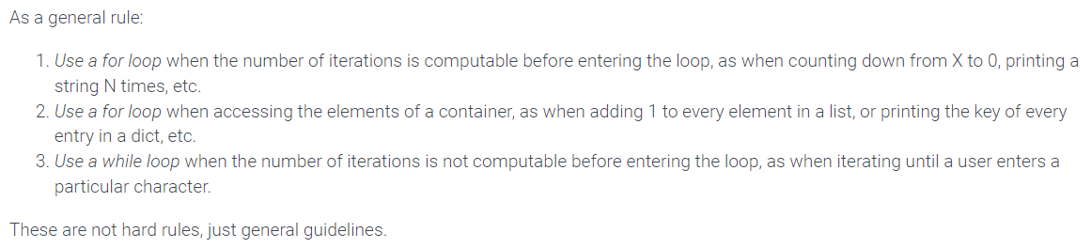
Chapter 6 – Loops
“While” vs “for” loops
How are these 2 different loop structures similar?
How are they different?
Which loop function is better?
When would it be better to use a while loop?
When would it be better to use a for loop?
Zybooks in class activities

Slide 30
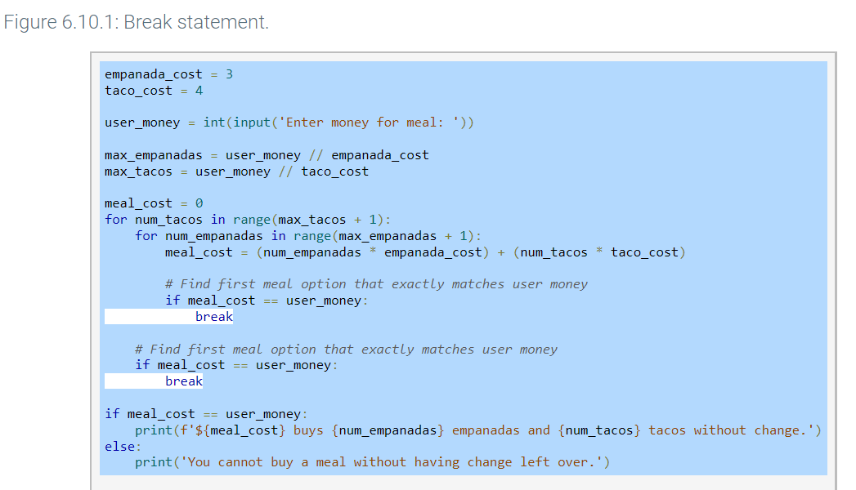
Chapter 6 – Loops
“break” and “continue”
A break statement in a loop cause the loop to exit immediately
In the nested loop below – there are multiple break statements.
Zybooks in class activities

Slide 31
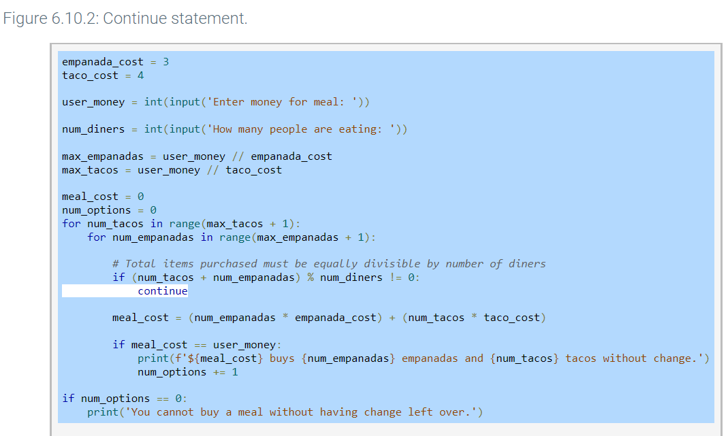
Chapter 6 – Loops
“break” and “continue”
A continue statement in a loop causes an immediate jump to the while or for loop header statement
Zybooks in class activities

Slide 32
Chapter 6 – Loops
Let’s write some code
Break into small groups and work on the following labs (some teams need to share the team’s solution before the end of class):
6.14 LAB: Convert to Reverse Binary
6.15 LAB: Adjust Values in a List by Normalizing
6.16 LAB: Exact Change
Zybooks in class activities

